Slide 1
Survivor Day 1
STANDARDS
8.LS4.3 Analyze evidence from geology, paleontology, and comparative anatomy to support that specific phenotypes within a population can increase the probability of survival of that species and lead to adaptation.
8.LS4.4 Develop a scientific explanation of how natural selection plays a role in determining the survival of a species in a changing environment.
SEP: Engaging in argument from Evidence
CCC: Cause and effect
I Can:
Analyze evidence from geology, paleontology, and comparative anatomy to support that specific phenotypes within a population can increase the probability of survival of that species and lead to adaptation.
Develop a scientific explanation of how natural selection plays a role in determining the survival of a species in a changing environment.

Slide 2
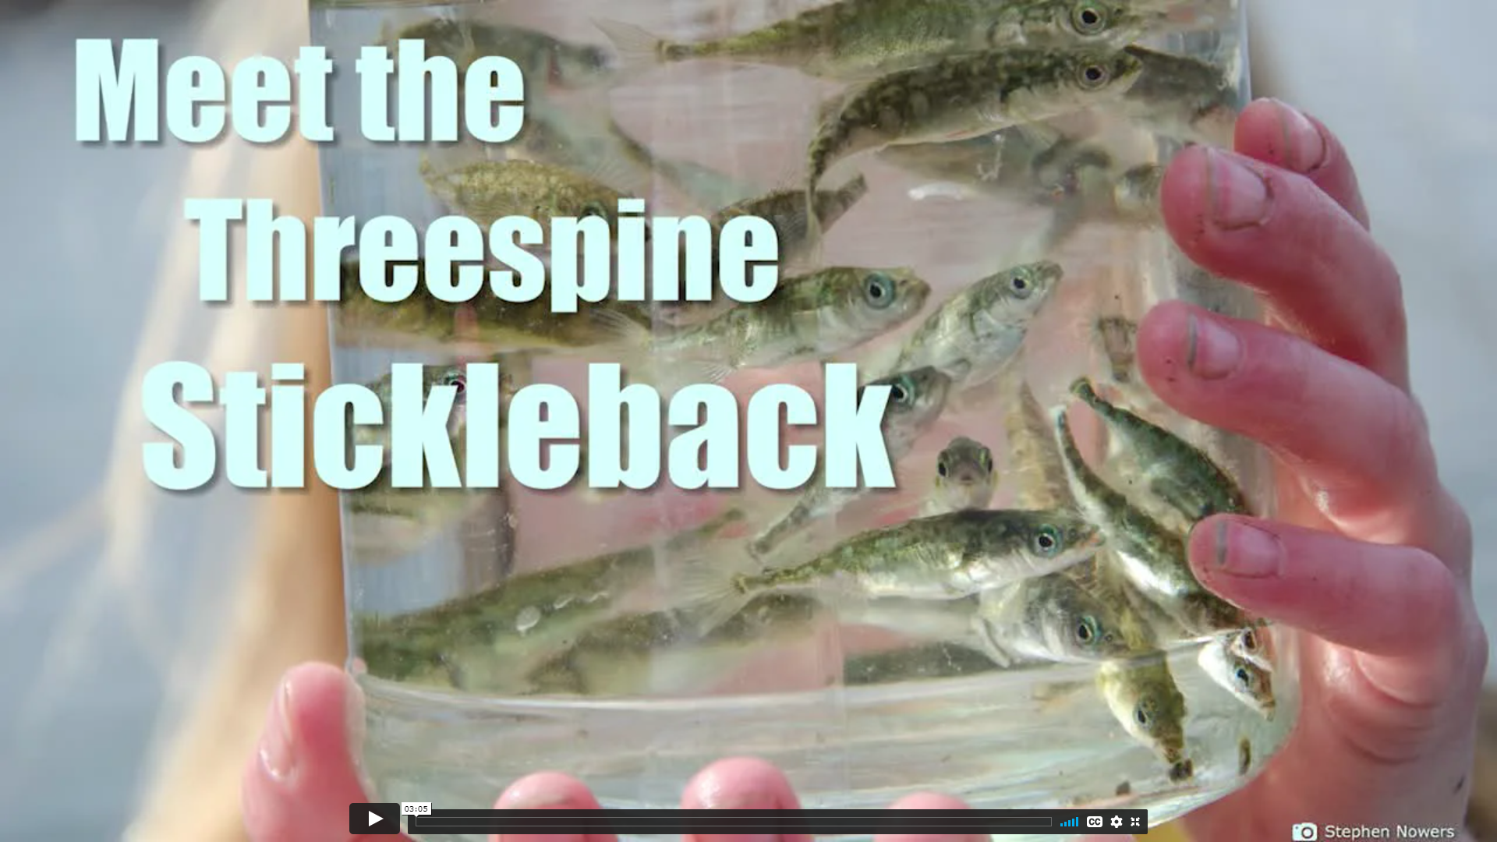
Watch the following video and write your observations on a piece of paper

Slide 3
Driving Question
Write the Driving question on your paper and develop an initial model and explanation about what will happen to the Loberg Lake stickleback fish population over time and why.
What will happen to the Loberg Lake stickleback population?

Slide 4
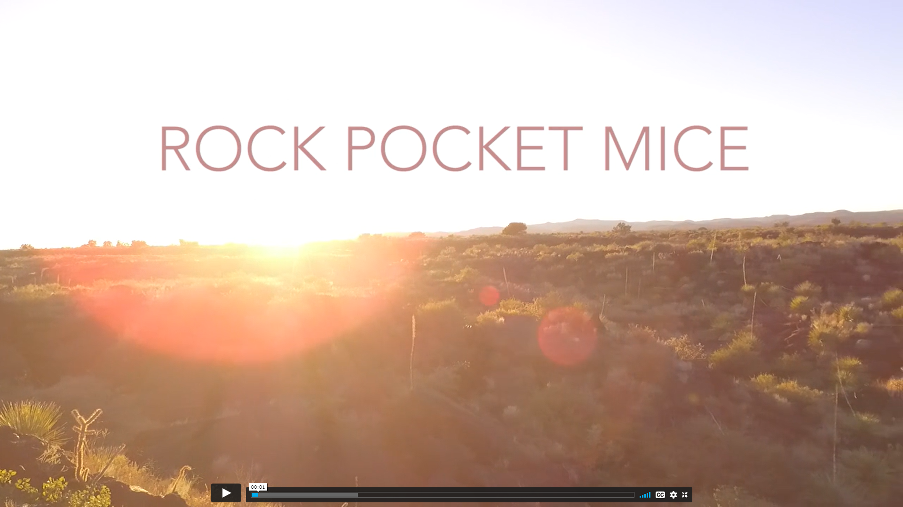
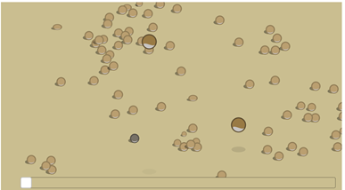
Investigate
Answer the questions in TEAMS as you watch the reproductive advantage simulation
Watch this video

Slide 5
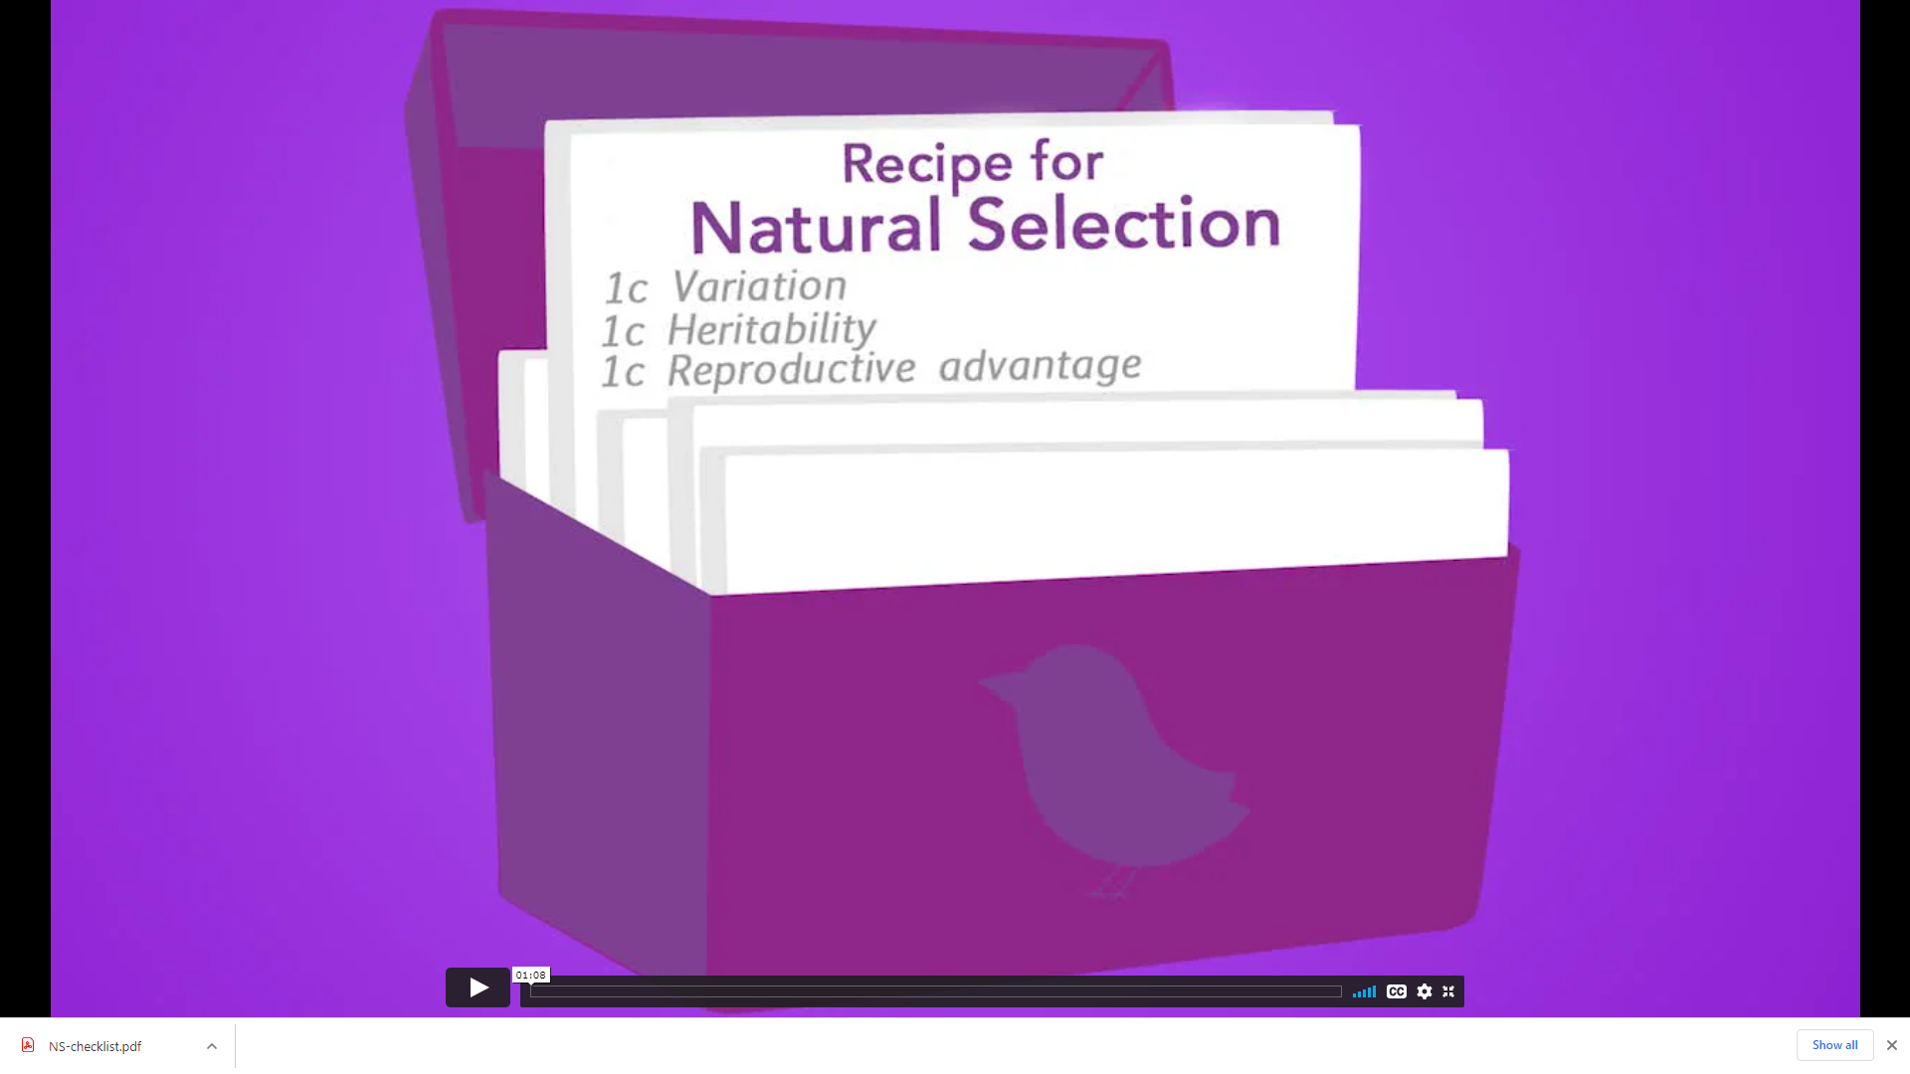
What is Natural Selection?
1.Watch “A Recipe for Natural Selection”.
2.Look at your copy of the Natural Selection Checklist. (in TEAMS)
3.Is the rock pocket mouse phenomenon an example of natural selection?
Use the Natural Selection Checklist to answer this question. You must provide evidence to support your decisions.

Slide 6
Revise your initial model for the Stickleback fish
(this is on your paper that the original model was on.)

